Slide 1
Let’s talk about dementia
dementiauk.org
info@dementiauk.org
@DementiaUK
7th Floor, One Aldgate, London EC3N 1RE
020 8036 5400
Dementia UK is a registered charity in England and Wales (1039404) and Scotland (SC 047429).
Notes:
Activity One: Before showing the next slide Ask the children in small groups, or as a whole class ,to think about one or all of the following questions.
What is dementia?
What are the symptoms?
What causes dementia?
How do you think it might feel to have dementia?

Slide 2
‘Let’s talk about dementia’ animation video
Notes:
Activity Two – This video will help children to understand what dementia is and initiate conversations and questions: https://www.youtube.com/watch?v=3kpD-Uykmww
Activity 3 – “It’s good to talk” – Ask the children to think about who they might talk to if they had worries or question (parents, grandparents, guardian, friends, teacher)

Slide 3
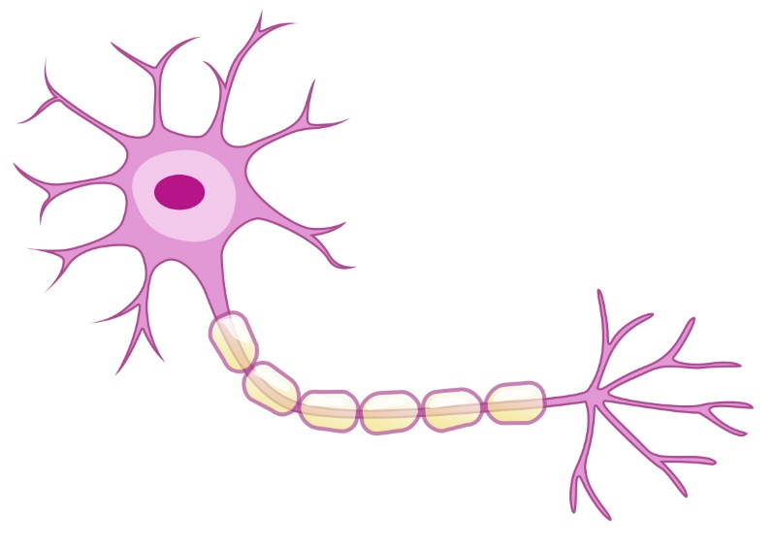
Nerve cells in the brain
The brain has billions of nerve cells (neurons) which carry messages between different parts of the brain.
Dementia causes damage to nerve cells which stops them from working properly.
Our brains control everything that we do, so if messages are not received, this will lead to difficulties.

Slide 4
The brain and dementia
Dementia affects people of all ages and is caused when the brain is damaged by disease.
This can lead to the following symptoms:
Memory problems (especially recent memories)
Difficulty with thinking, planning and problem-solving
Problems with speaking, such as finding the right words
Changes in personality, mood and behaviour
Balance and movement issues
Difficulty with managing everyday tasks such as washing, dressing and eating
Notes:
You can refer back to the questions in activity one to see if anyone mentioned any of these

Slide 5
Types of dementia
There are many different causes of dementia, which can affect different parts of the brain in different ways. The most common types of dementia include:
Alzheimer’s disease
Vascular dementia
Lewy body dementia
Other types that are more likely to affect younger people (aged under 65) include:
Frontotemporal dementia (FTD)
Posterior cortical atrophy (PCA)
There are many other types of dementia.
Notes:
Dementia is described as ‘young onset’ when the person’s symptoms develop before the age of 65. There are over 70,800 people in the UK estimated to be living with young onset dementia. The impact on a child who has a parent with dementia is likely to be very different to a child who has a grandparent or other relative who has a diagnosis.

Slide 6
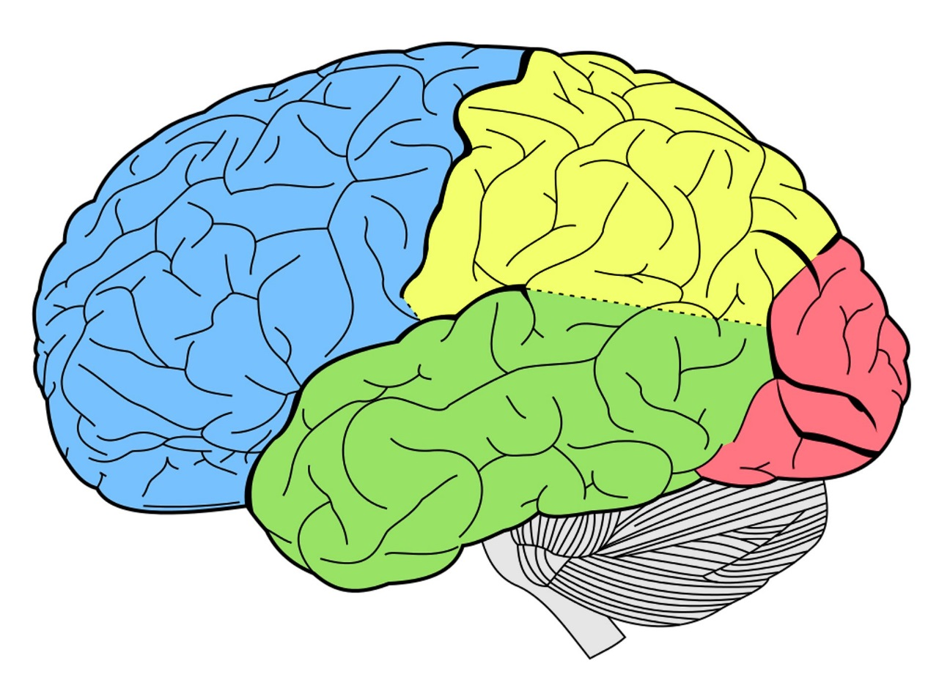
Dementia affects how the brain normally works
Parietal lobe - controls awareness of our surroundings and coordination
Frontal lobe -
controls thinking, planning, solving problems and behaviour
Occipital lobe - helps us interpret what we see
Cerebellum
- controls balance and movement
Temporal lobe - controls memory, learning and understanding
Language and speech
Notes:
Activity Three – Memory game – Place ten small objects on a tray. Ask one of the children to volunteer. Give them a minute to memorise them and then ask them to turn their back while one or two objects are removed. Can they work out which ones are gone?
Alternatively cover objects up and allow five minutes or so and ask the children to recall them. This can be made more challenging by using background noise (music, laughing or chatting.) Ask the children how they felt about it. (Easy? Frustrated when they forgot? Annoyed by background noises?)
Aim – To demonstrate that we can all struggle to remember especially when distracted by noises or under pressure. People with dementia can experience forgetting things regularly which can cause them to be frustrated and worried.
Activity Four – Drawing a star – You will need a small mirror, a pencil or pen and a blank sheet of paper OR a piece of paper with an outline of a star. (If you have an empty shoe box cut out both ends so a child has to put their hand though the holes. This works even better) In pairs, ask one of the children to hold the mirror so it is upright on the table and on the edge of the paper , facing the other child. Ask this child to draw a star OR around the star but only looking at the mirror, NOT at the piece of paper or their hand.
(Ask them how they feel: Frustrated? Silly?)
Aim -This will help demonstrate how difficult it can be to coordinate movements and what happens when perception is altered. This may be a problem if the parietal lobe and/or occipital lobe are affected and helps us to understand how people might feel when they can’t carry out what feels like a simple task.

Slide 7
How do you think it might feel to have dementia?
Everyone is individual, so the condition and their ability to cope with the symptoms will affect them in different ways.
Different types of dementia can lead to different parts of the brain being affected.
In the early stages of dementia, people can often manage independently or with very little help.
But, as the condition progresses, people will need more support and understanding, especially from family and friends.
Notes:
You can refer back to the questions in activity one to see if anyone mentioned any of these things.

Slide 8
How and when to help
It’s important for people with dementia to stay as independent as possible but this will become more difficult as their symptoms get worse.
Helping them may be seen as interfering, so it is not always easy to know how and when to provide support.
Asking the person if they would like some help to do something can make it easier for them to accept.
Notes:
Activity Five -
A useful activity can involve asking the children to remember when they needed help with something (riding a bike, swimming, homework, reading) and then ask them to think about activities they don’t need help with anymore and can do on their own (dressing, eating, cycling, swimming)
Ask – How do they feel when they’ve achieved it ?( clever, independent, proud)
- How would they feel if someone said they couldn’t do the things they know they can and wanted to interfere or help them? (frustrated, annoyed, demonstrate you can)
Aim – To help them understand how important it is to achieve things on your own. Sometimes people with dementia don’t think they need help as they’ve already achieved so many things in their life .They can forget the condition effects their abilities to those things we take for granted now. It’s easier to accept help when it’s offered than to ask for it.

Slide 9
What else can help?
Hobbies and interests
Notes:
Activity Six -
Ask the children to think about some of the things they do with parents or grandparents (reading, gardening, baking, games). They can write them down or discuss.
Ask them how doing some of those activities might affect the person if they had dementia.
Get them to think about and discuss ways that they could still enjoy doing activities together. i.e. Give them more time to read or read to them; bake cakes with simpler instructions to follow . Watching cooking programmes together or looking through their old cookery books. Do small jobs in the garden together, look through, colourful garden books. Make a scrap book with them of their memories and hobbies.

Slide 10
Fun and helpful activities
Although a person with dementia can forget recent memories, they often remember older ones such as their job, wedding, hobbies and even childhood memories and music.
Memories can be collected in different ways and new memories can be made by doing things together:
Scrap books – containing pictures, photos and memorabilia
Memory box – containing significant and important objects and decorated on the outside to make it personal
Downloading favourite music that you can listen, sing or dance to together
Watching favourite films or television programmes
Reading books or going for walks together
Notes:
For more idea and activities see link below:
https://generationsworkingtogether.org/downloads/5623fa02efea7-Dementia%20Pack%20for%20Primary%20school%20ver10.pdf
The above activities can be great for everyone and not just a person with dementia. The children could do it in the classroom or as homework for a relative in their family (grandparent, parent ) or their own scrap book of memories, hobbies and things they enjoy doing.

